Slide 1
Social Network Analysis Class (Spring 2019) Jieun Shin
Introduction
1) Introduction
2) Overview of Social Network Analysis
3) Network Data Collection & Basic Measures
4) Personal/Ego-centric Methods
Measures & Methods
5) Fundamental Network Concepts 1 (Centrality)
6) Fundamental Network Concepts 2 (Groups)
7) Fundamental Network Concepts 3 (Positions)
8) Network Level Measures (Reciprocity & Transitivity)
9) Hypothesis Testing (ERGM)
Applications
10) Diffusion & Innovations
11) Digital Media & Network
12) Presentation
13) Presentation
14) Final Project

Slide 2
Online networks: Two basic questions
What are my nodes?
What constitutes a relation between two nodes ?

Slide 3
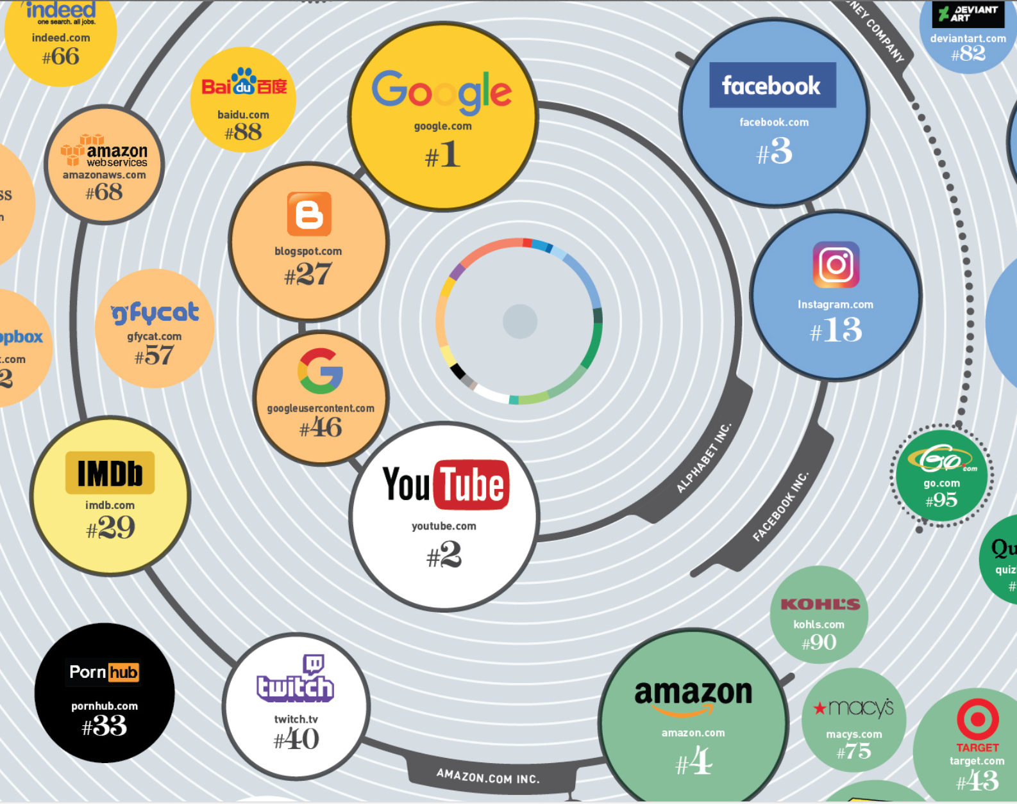
Notes:
http://www.visualcapitalist.com/wp-content/uploads/2017/03/top-100-websites.html

Slide 4
Network Types
Type | Nodes | Edges
Social Networks | Individuals | Relationship
Communication Networks | Individuals | Communication
Affiliation networks | Individuals - Groups | Membership
Co-purchasing networks | Products | Co-purchasing
Text networks | Words | Co-occurrence
Notes:
https://snap.stanford.edu/data/

Slide 5
Affiliation Network

Slide 6
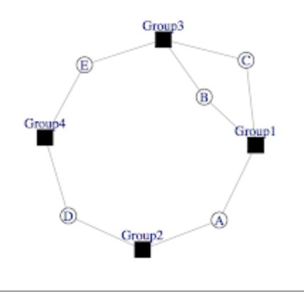
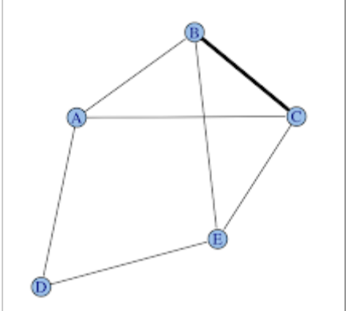
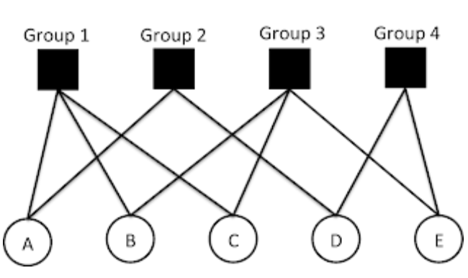
Example

Slide 7
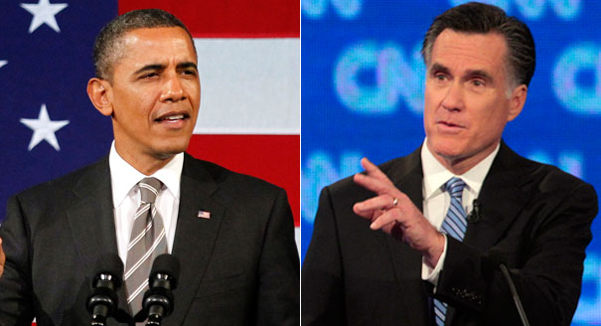
Diffusion of Political Rumors on Twitter During the 2012 U.S. Presidential Election
Shin, J., Jian, L., Driscoll, K., & Bar, F. (2017). Political rumoring on Twitter during the 2012 U.S. Election. New Media & Society

Slide 8
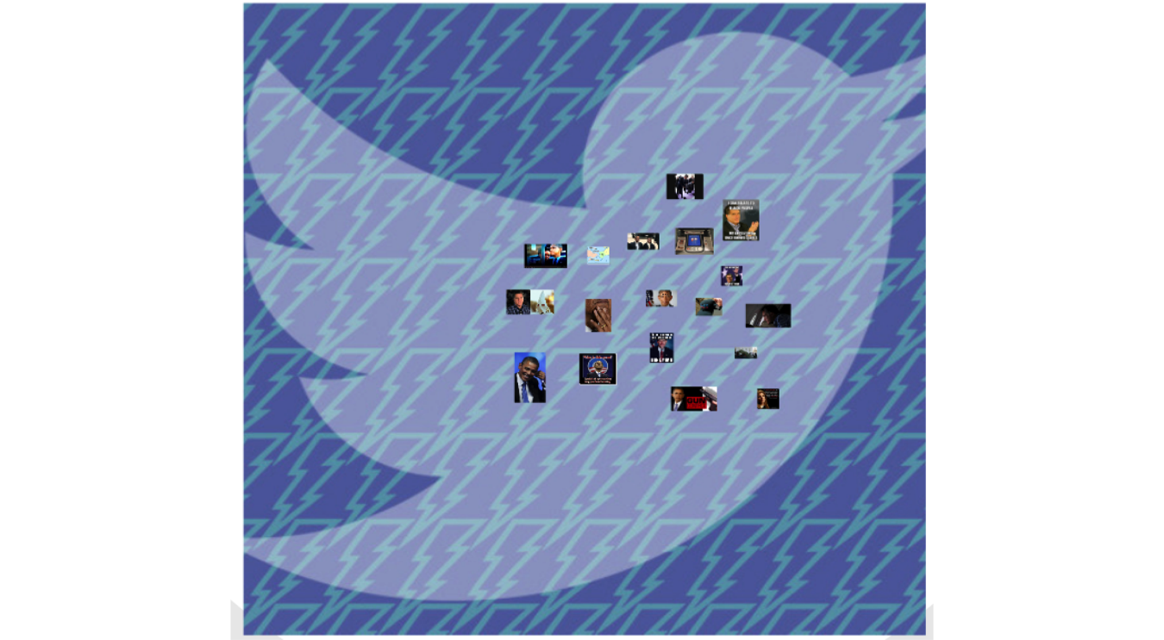
Data
57 rumors investigated by 3 fact-checking websites
Access to the 100% of the Twitter data (Firehose) in real time

Slide 9
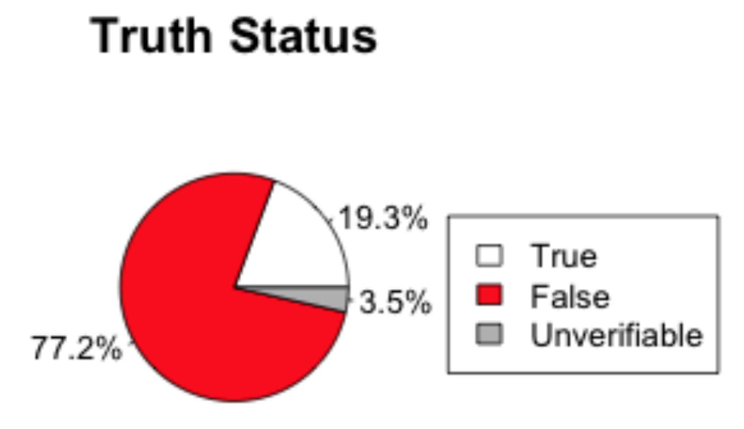
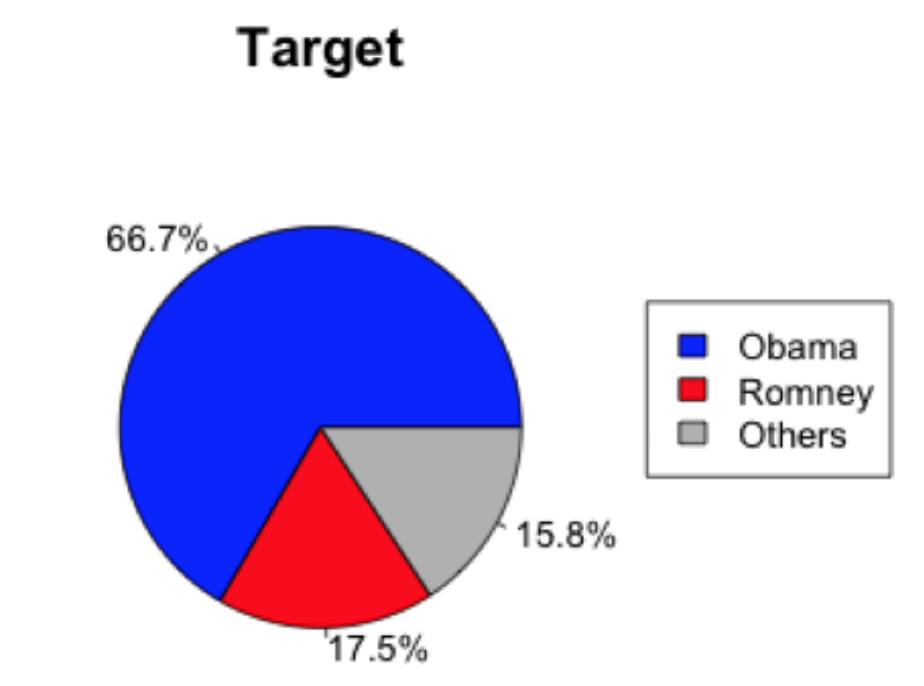
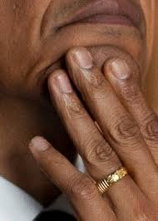
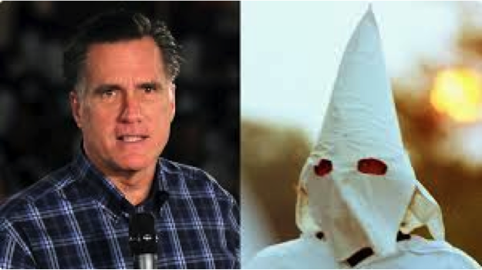
Descriptions of these rumors

Slide 10
Keyword search + Content coding
Retrieved 439,556 tweets that contained matching keywords for each rumor
Worked with 8 undergrad coders for 11 months
Coded tweets for two variables
Is it about the rumor ?
What is the attitude? (endorsing, rejecting, or unclear?)

Slide 11
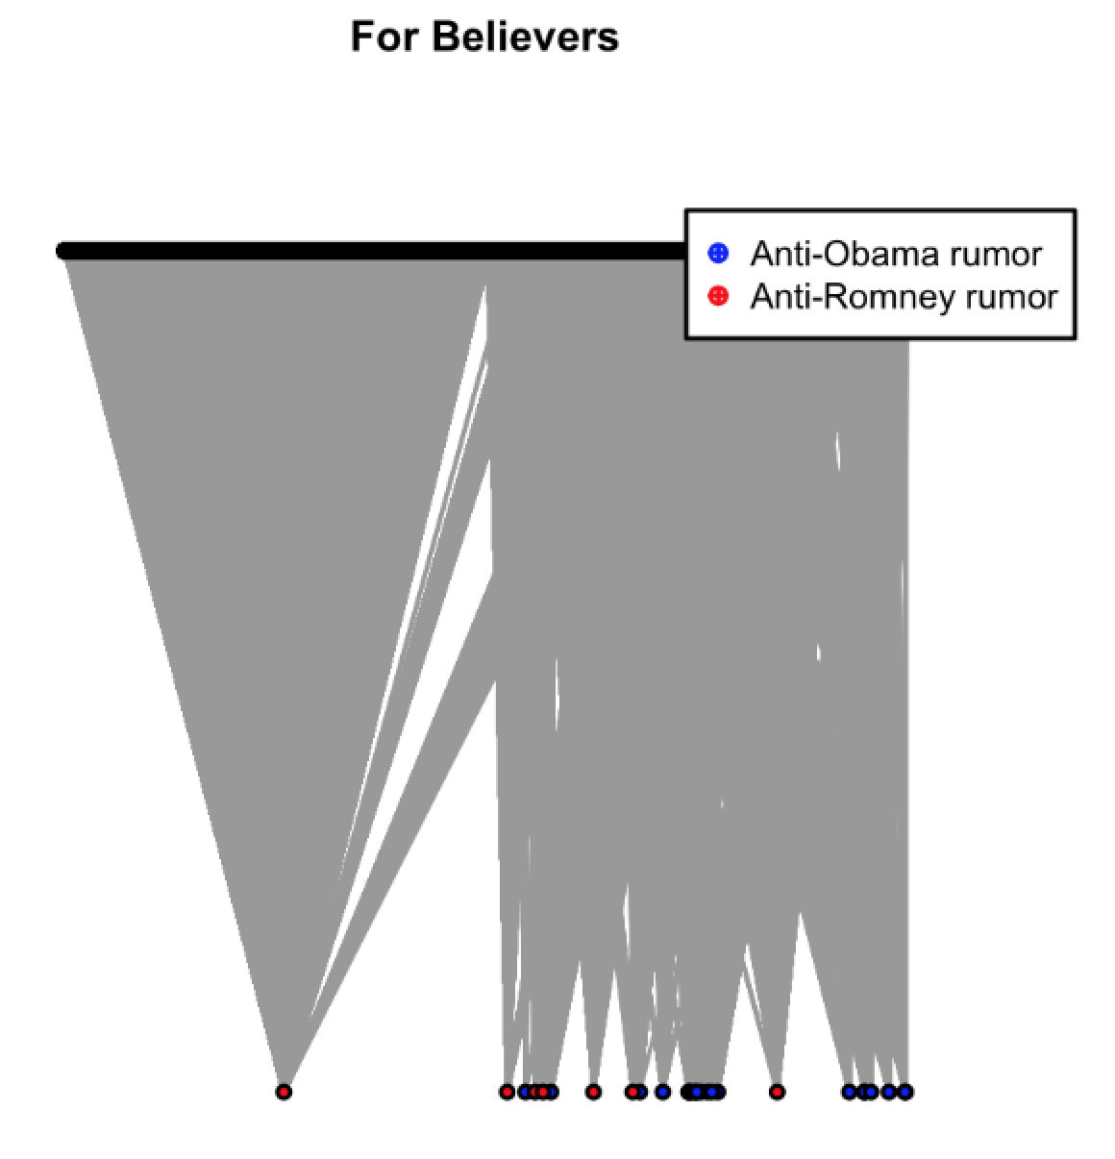
1. Affiliation Network Relationship between rumors and their spreaders
Notes:
28 rumors * 176,149 users

Slide 12
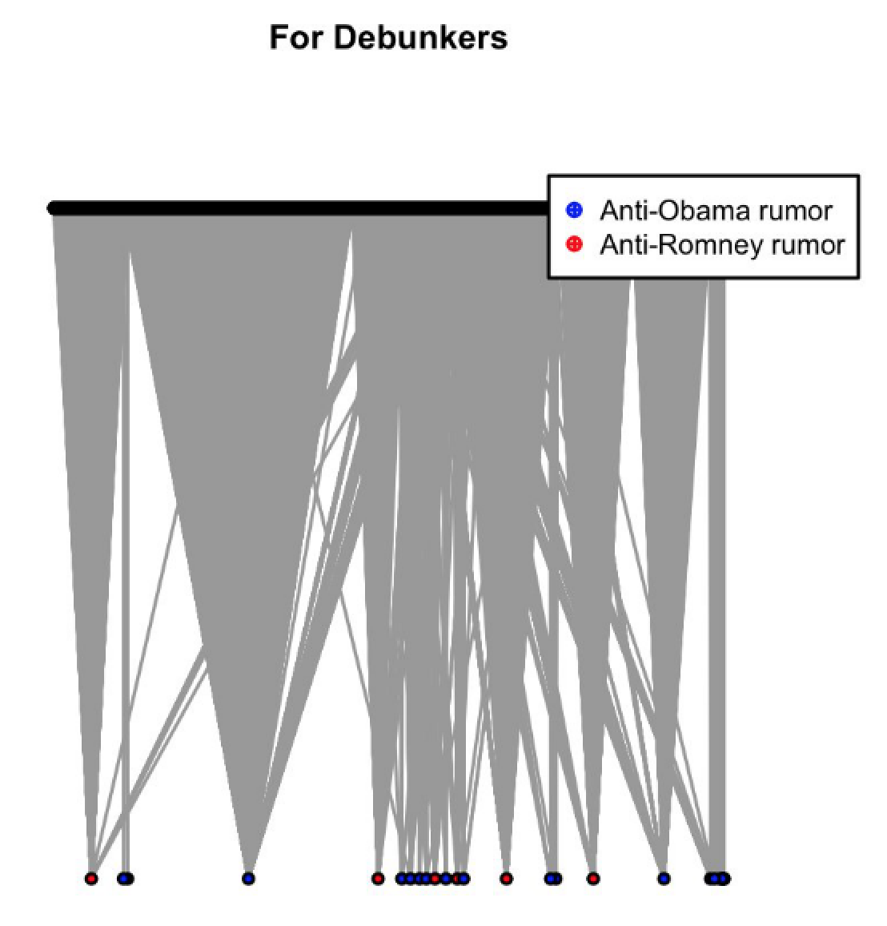
Relationship between rumors and their debunkers

Slide 13
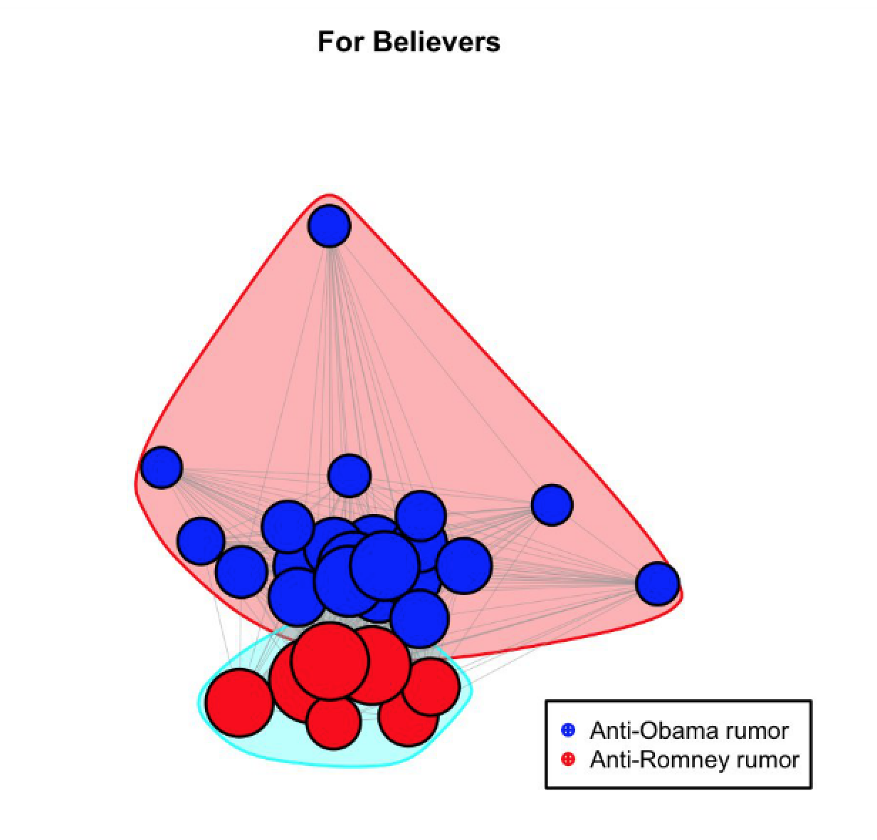
Polarized Network for Rumor Spreaders

Slide 14
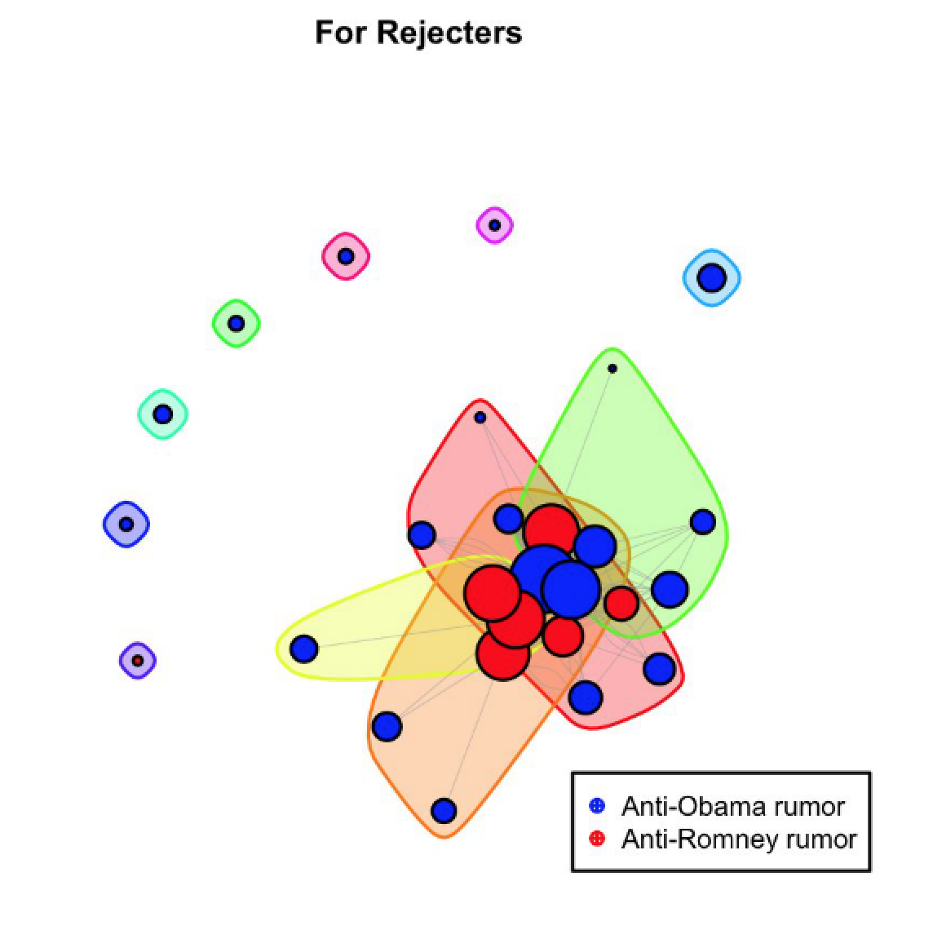
Cross-Cutting Network for Rumor Debunkers

Slide 15
Communication Network

Slide 16
Example
Retweet Network

Slide 17
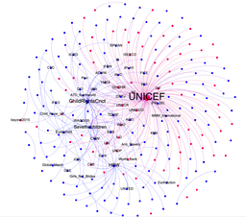
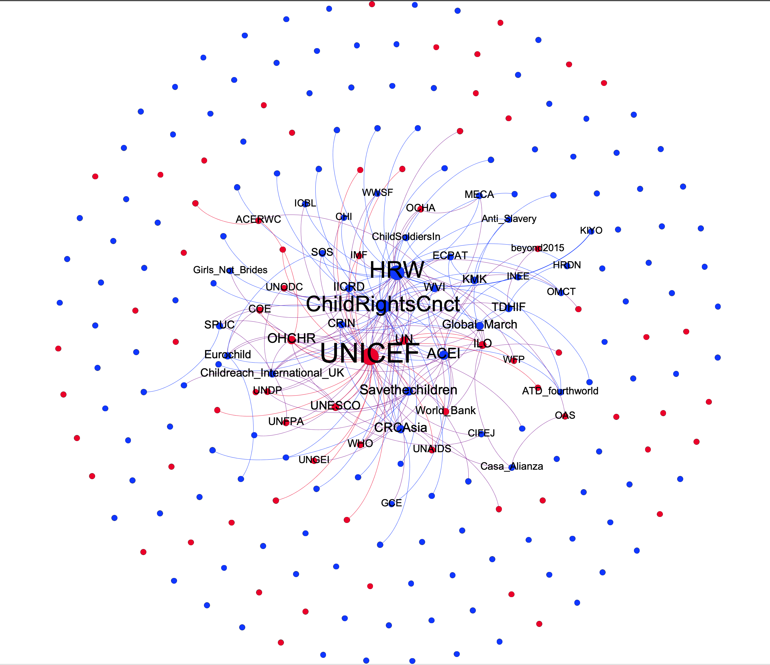
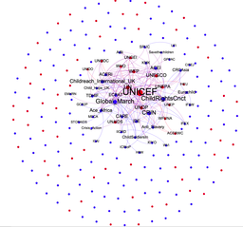
URL network
Offline
Twitter
Liu, W. & Shin, J.
Convergence or Divergence: Exploring Different Mechanisms Driving Children’s Rights Organizations’ Offline versus Online Interorganizational Alliance Building

Slide 18
Text (Word) Network

Slide 19
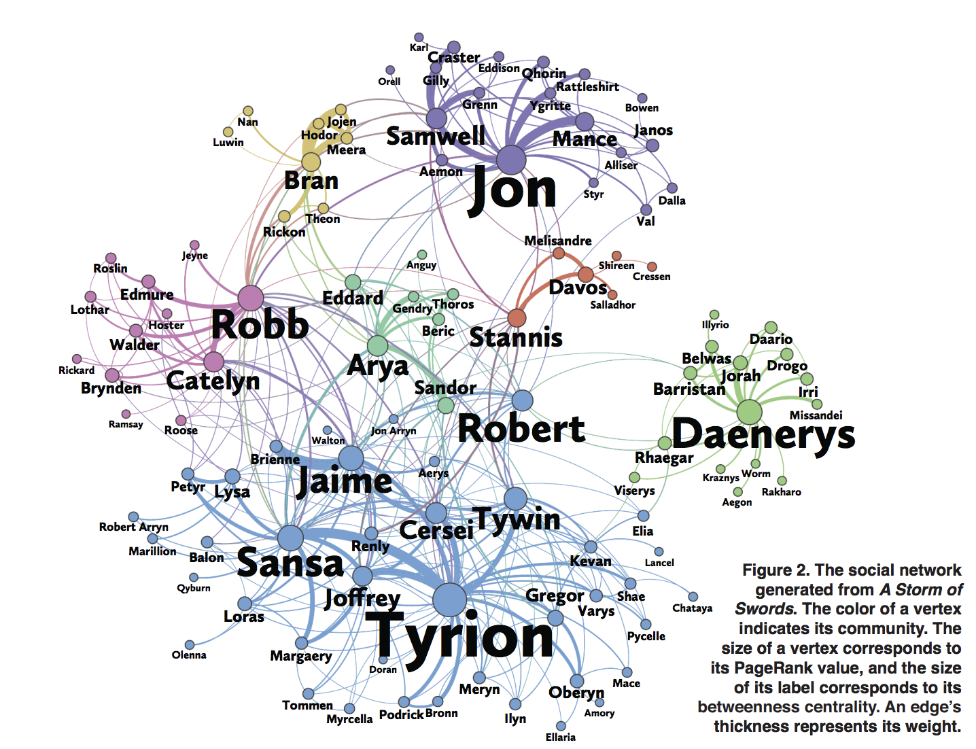
A social network expressed in the text ( )

Slide 20
The text as a network !
Defining a unit of text : word, n-grams ?
Defining relationships
- words connect into graph if they occur together in a certain context ?
- words connect into graph when they are near each other (bigram, 4-gram, sentence, a tweet, paragraph, etc)
Selecting nodes
-It’s common to strip stop words (e.g., in, on, of, and, or, but, likely, somehow, etc)
Abstracting nodes :
- stemming : goes, went -> go ; sail, sailer, saling -> sail

Slide 21
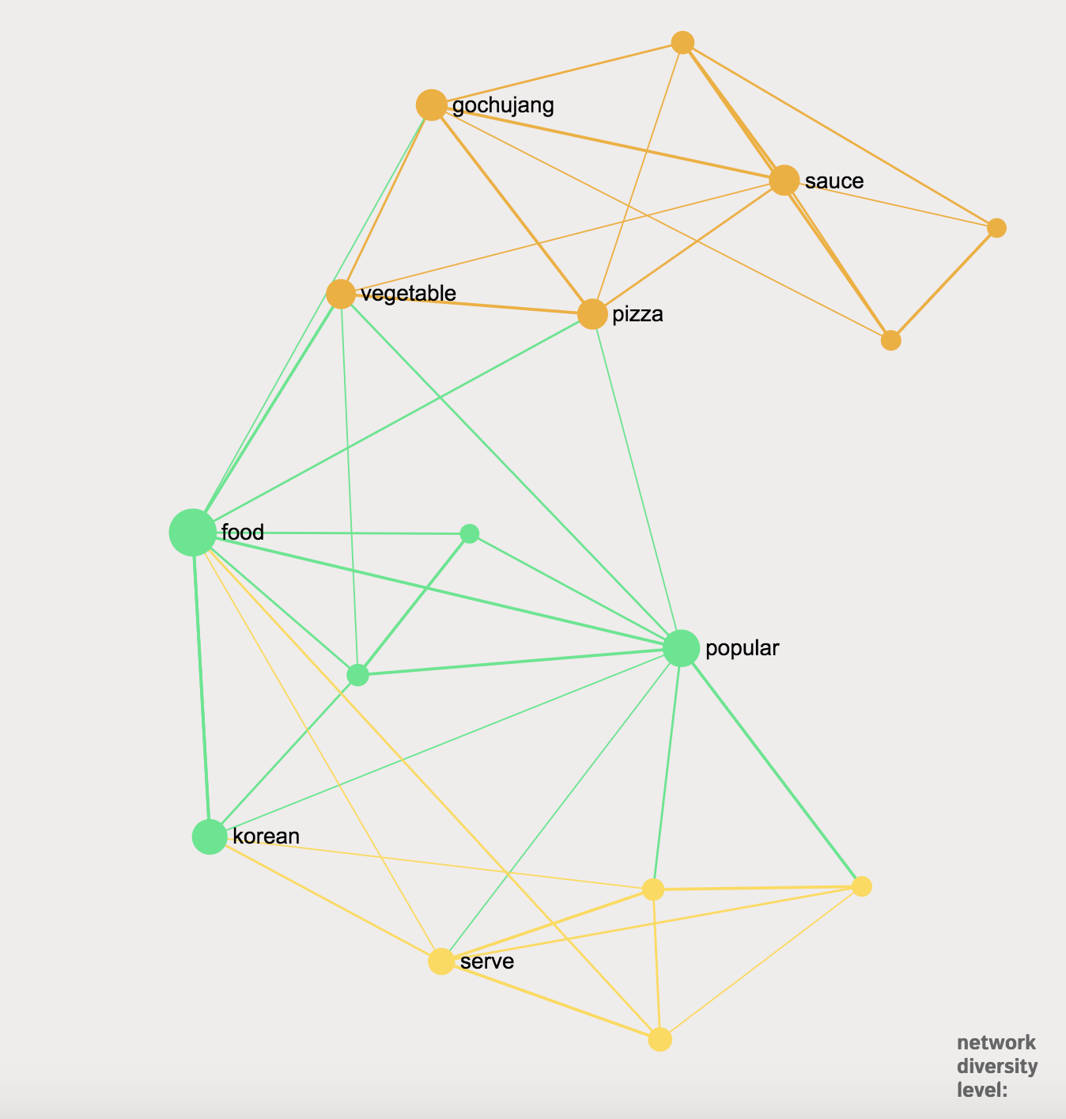
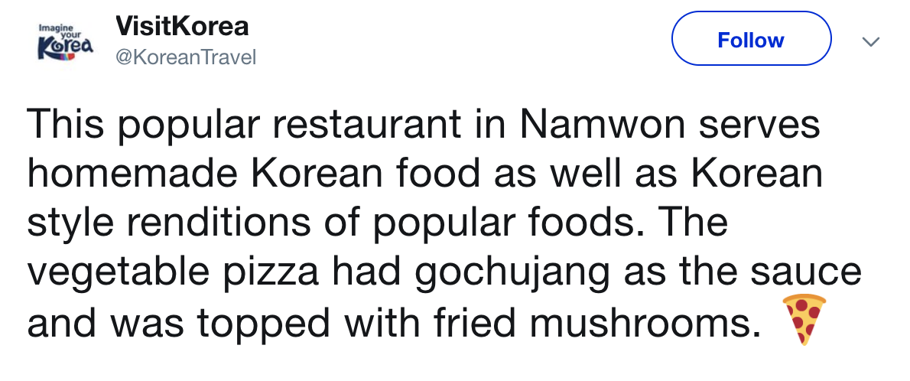
Example

Slide 22
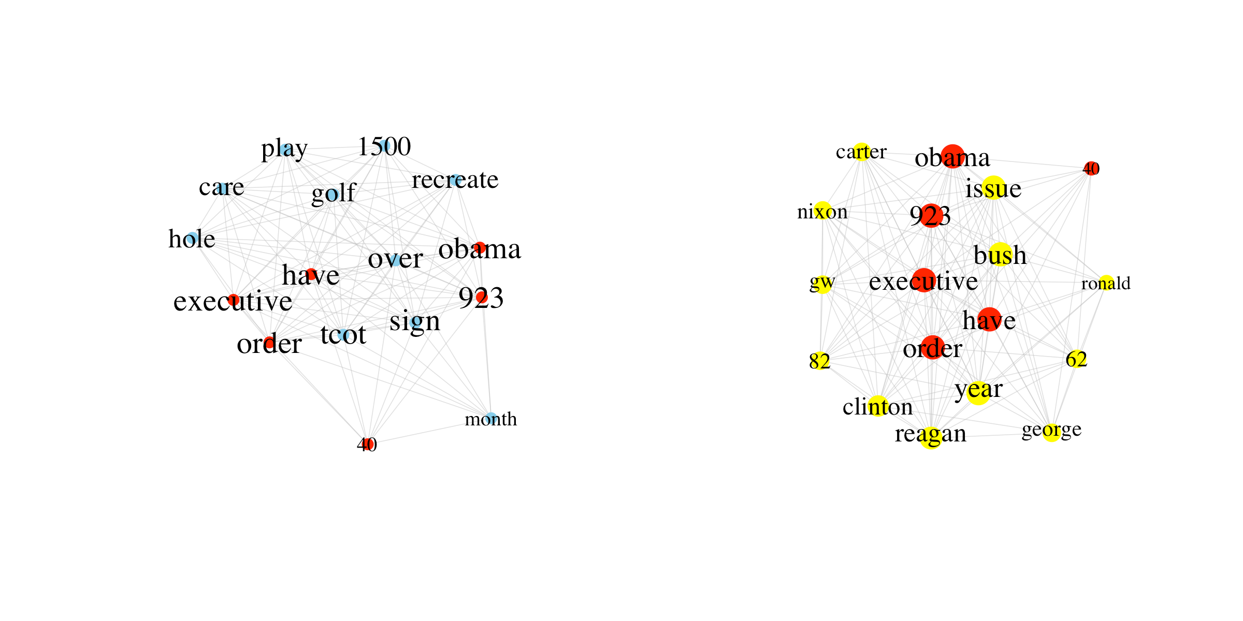

Shin, J., Jian, L., Driscoll, K., & Bar, F. (2018). The diffusion of misinformation on social media: Temporal pattern, message, and source. Computers in Human Behavior, 83, 278-287
Cosine Similarity = 0.38
Peak #1: Obama has signed 923 executive orders while playing over 1500 holes of golf
Peak #3: Obama has signed 923 executive orders in 3.5 years Nixon 1 in 6, Carter 3 in 4, Reagan 5 in 8, Bush 3 in 4, Clinton 1 in 6, GW Bush 62 in 8
More than half rumors show changes in their narratives

Slide 23
Co-purchasing Network

Slide 24

Amazon.com

Slide 25
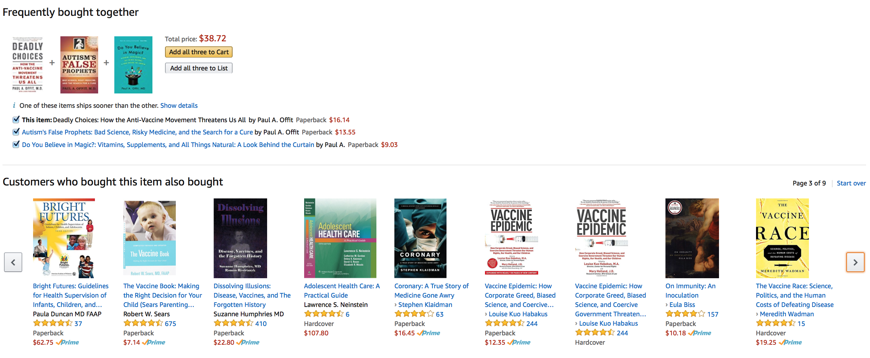

Slide 27
Social Network + Experiment

Slide 28
Centola (2010) : the spread of behavior in an online social network experiment
Recruited 1528 participants from a health community
Each person created an anonymous profile
Randomly assigned to one of two experimental conditions – a clustered lattice network vs. a random network
Participants could only see the immediate neighbors
Diffusion was initiated by selecting a random “seed node”
Seed node sent signals to its network neighbors encouraging them to adopt a behavior (signing up for a health forum)
Every time a participant adopted the behavior, messages were sent to her buddies inviting them to adopt
Each session ran for 3 weeks

Slide 29
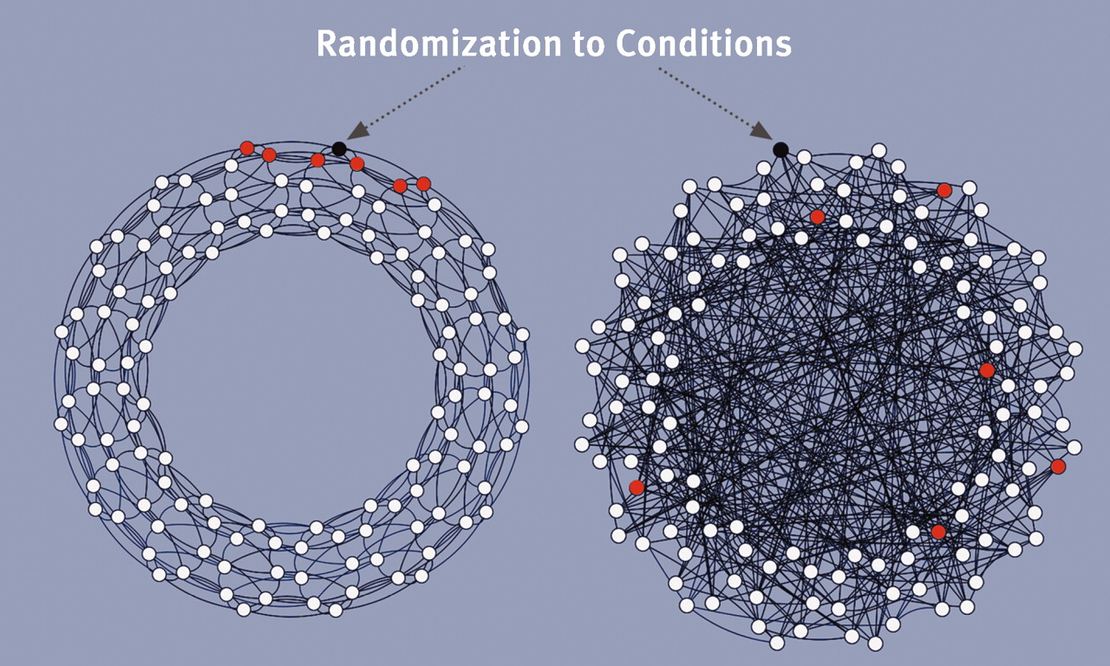
Notes:
a network with more clustering may is more advantageous for behavior diffusion.

Slide 30
Social Network + Diffusion

Slide 31
Diffusion of Twitter among Health NGOS

Slide 32
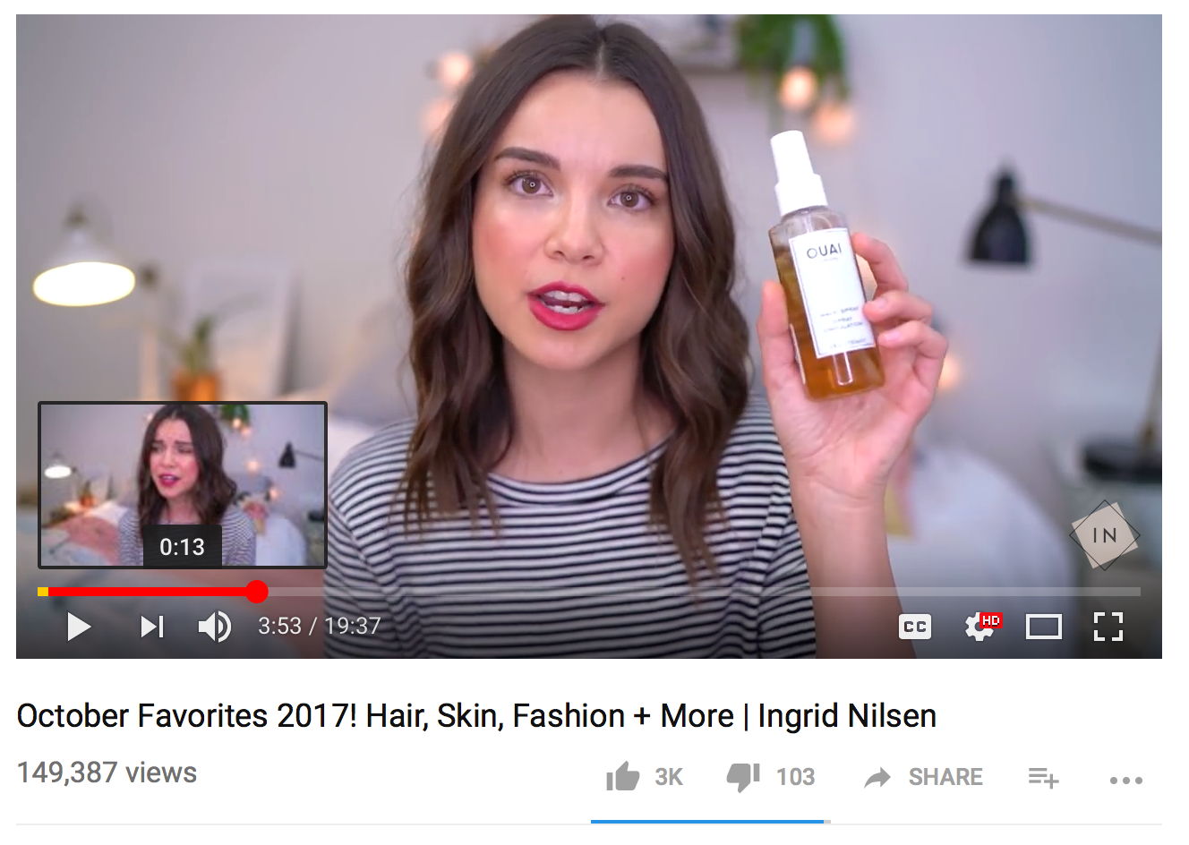

Future Projects
Social media influencers :
Who creates trends ?
Which foods earn the status of “superfood” ?
Marketing vs. Scientific evidence
32

Slide 33
Pitfalls of using social media data (Zeynep Tufekci, 2014)
Implicit and explicit structural biases of the platform
- Twitter: public, directed-graph, ease of use, bots
- Facebook: private, undirected-graph
- Confounding factors: recommendation algorithm

Slide 34
Pitfalls of using social media data (Cont’d)
Lack of clarity with regard to sampling, universe, and representativeness
-Twitter Firehose, Search API, Streaming API
Search goes back in time and streaming goes forward
-Insufficient understanding of the underlying sample and denominators
(e.g., retweet /exposure)

Slide 35
Pitfalls of using social media data (Cont’d)
Network structure does not reveal all
- frequent ties vs. infrequent ties ?
Most big data analyses come from a single platform
Some researchers lack understanding of the platform
Notes:
Structural + situational

Slide 36
NODEXL
a data scraping, visualization, and analysis tool created by researchers at Microsoft as an add-on to Excel
Maintained by the Social Media Research Foundation
graphing social media communities, it has built-in features for grabbing the data for you
Uses APIs (application programming interface) to interact with social media platform databases
Limited datasets (API – rate limited, 3200 tweets, limited amount per 15 minutes)
Recent data only

Slide 37
Available Social Media
Facebook Fan page network
Facebook personal network
Flicker
Media wiki page network
Twitter Search Network (#hashtag, keyword, other)
Twitter user’s network
YouTube user’s network
YouTube video network

